Slide 1
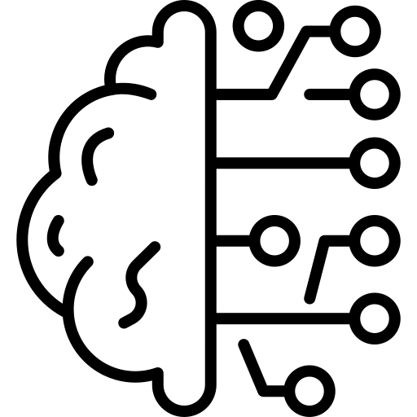
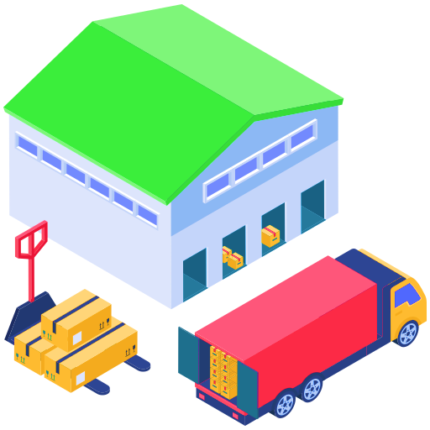
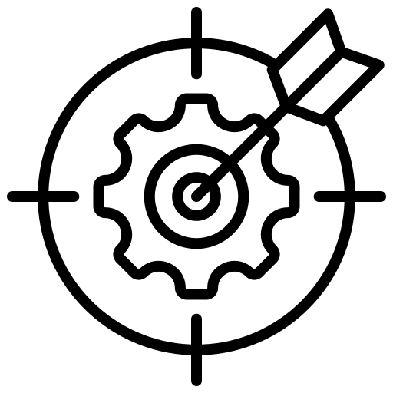



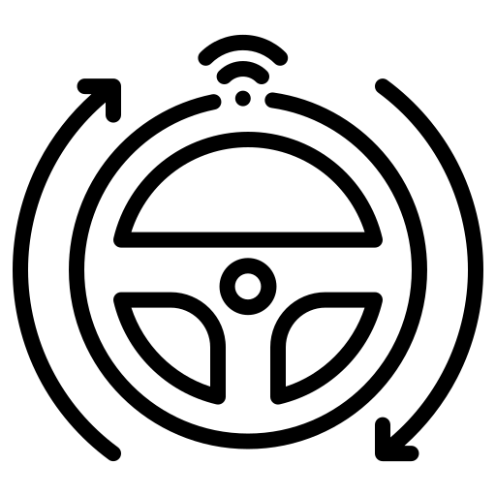



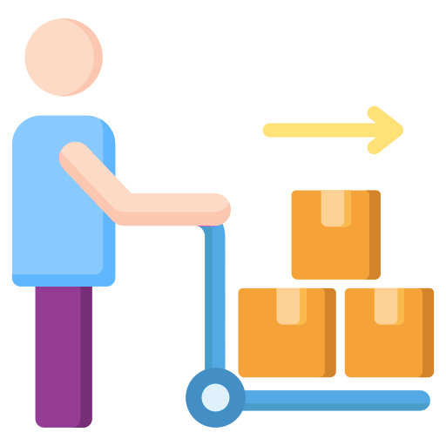
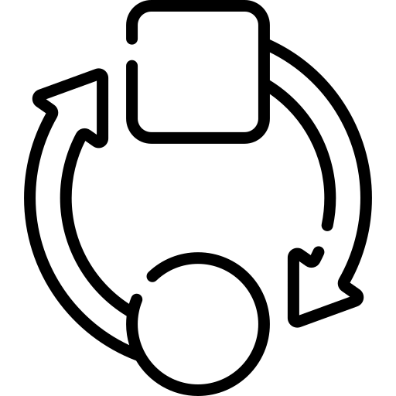


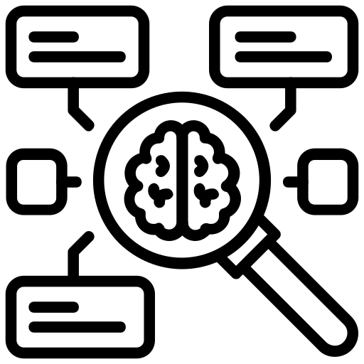
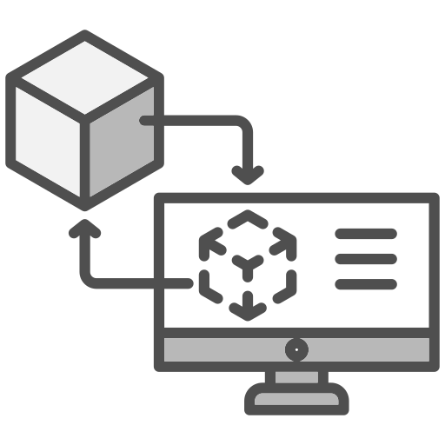
DT characteristics
Multimodal Modeling
5
Fidelity
6
Synchronization
Autonomy
7
3
Continuous Evolution
8
Adaptability
9
Feed back and Control
Context awareness
10
Physical Entity
Virtual Copy
1
2
4
Cyber security
11
Human in the loop
Assets and machines
Information systems
Cognition
12
Physical environment

Slide 2
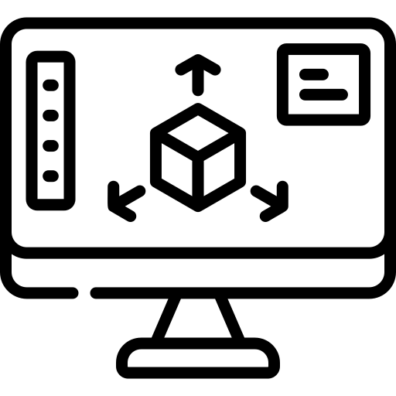
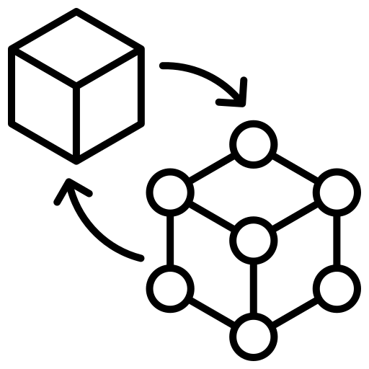


Pre-digital twin
Digital twin levels
Digital Model
Digital Shadow
Interactive Twin
Predictive Twin
Autonomous Twin
Cognitive Twin
Virtual Copy
Multimodal Modeling
Fidelity
Physical Entity
Synchronization
Cyber security
Feed back and Control
Context awareness
Continuous Evolution
AI and advanced modeling
Adaptability
Autonomy
Cognition
Advanced AI
Reasoning and decision making
DT maturity levels and requirements

